Slide 1
Polar regions in the Solar System
Lecture #2
A Tour of the Solar System
By Emmanuel Marcq, LATMOS/UVSQ

Slide 2
Outline
Telluric bodies: planets and moons
  Mercury
  Venus
  Earth & Moon
  Mars
  Titan
  Triton & Pluto
Giant planets
  Jupiter & Saturn
  Uranus
  Neptune

Slide 3
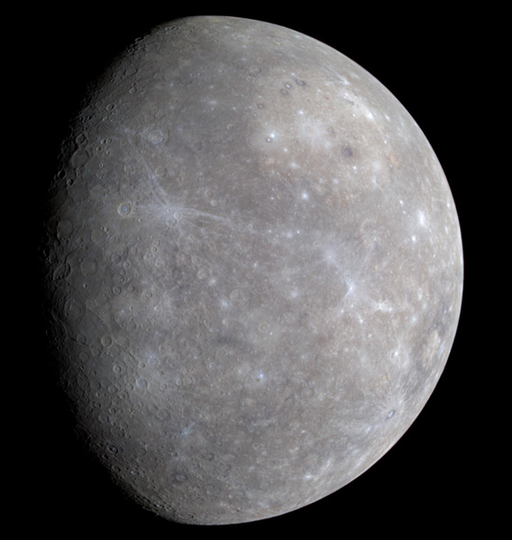
Mercury
Small rocky planet
  Smaller than some satellites
Looking alike the Moon
  Craterized surface
  No atmosphere
Surface temperature
  Dayside : + 450°C
  Nightside : – 150°C
Mercury as seen by Messenger

Slide 4
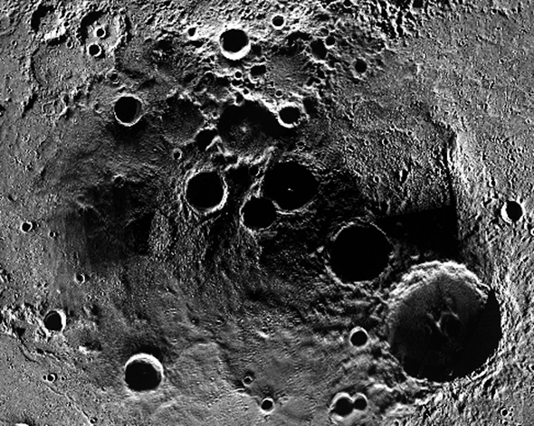
Mercury polar regions
Almost no axial tilt
Magnetic poles close to geographical poles
Polar regions :
  Peaks of Eternal Light
  Craters floors perpetually dark: primordial and/or cometary ice present ?
Mercury’s North Pole

Slide 5
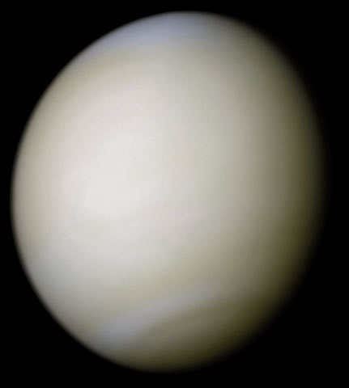
Venus
Rocky planet
  Size and mass similar to Earth
Dense atmosphere
    CO₂ (96,5 %), N₂ (3,5%)
    Surface pressure = 91 atm
    Sulfuric acid clouds (covering 100 %)
Huge greenhouse effect
  Surface temperature close to + 470°C
Venus seen by Mariner 10

Slide 6
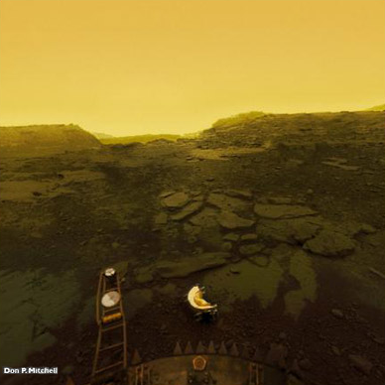
Venus surface
Venus panorama computed from Venera 15 pictures

Slide 7
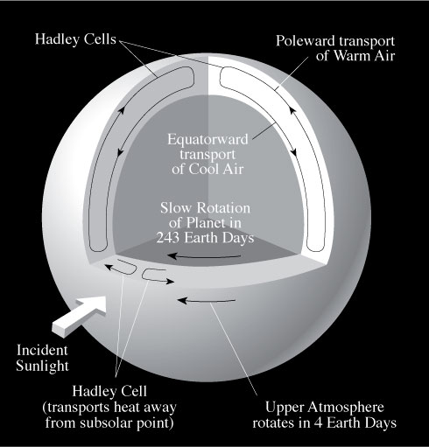
Venus’ atmospheric circulation
Super-rotation
  Atmosphere rotating faster than solid surface

Slide 8
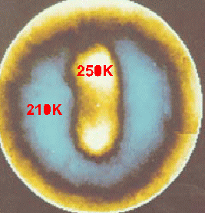
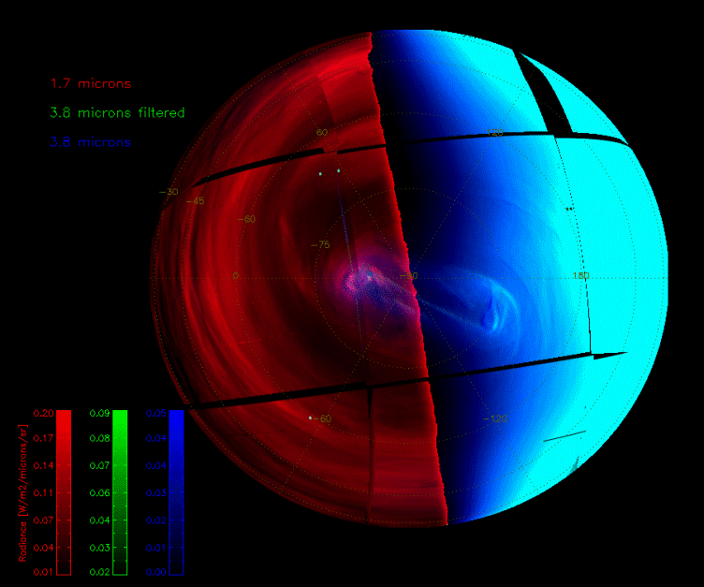
Venus’ polar regions
Hadley-cell circulation breaks down past 80°N/S
Polar vortices
  North : discovered by Pioneer Venus (1978)
  South : discovered by Venus Express (2006)

Slide 9
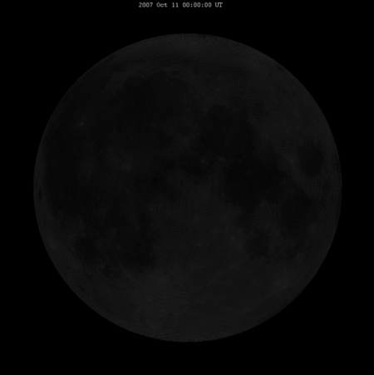
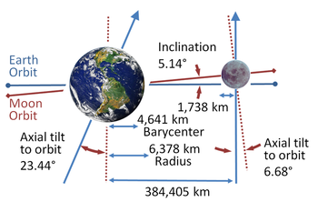
The Moon
Rocky body
  Thought to originate from a giant impact on primitive Earth
Almost no atmosphere

Slide 10
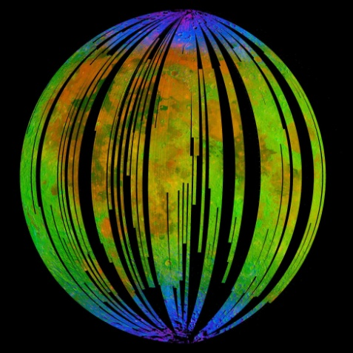
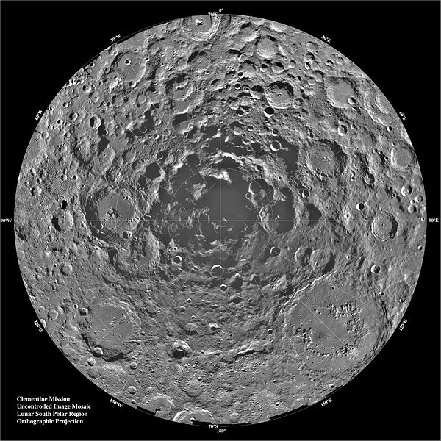
The Moon’s polar regions
Very low inclination
  “Peaks of eternal light” and “craters of eternal shadow”, esp. near Southern pole
Possibility of water ice bound to rocks at high latitudes
  Polar regions most convenient places for future settlements ?
Mineralogic map from MMM onboard Chandrayaan-1 (blue : -OH)
South Pole seen by Clementine

Slide 11
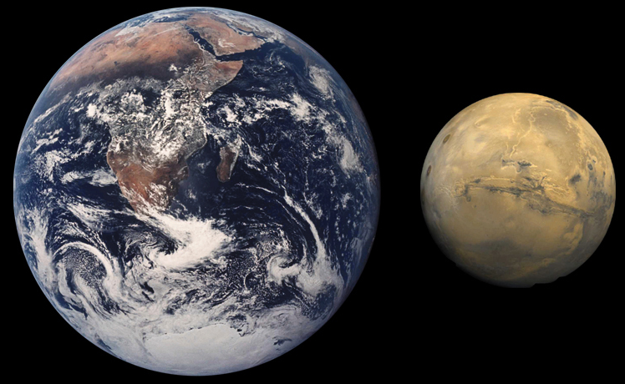
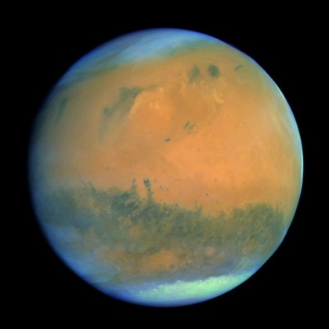
Mars
Small rocky planet
  Area: ~ 1/3 Earth
  Mass: ~ 1/10 Earth
Thin atmosphere
    CO₂ (96,5 %), N₂ (3,5%)
    Surface pressure = 6 mbar
Large seasonal and diurnal temperature variations
    « Hypercontinental » climate

Slide 12
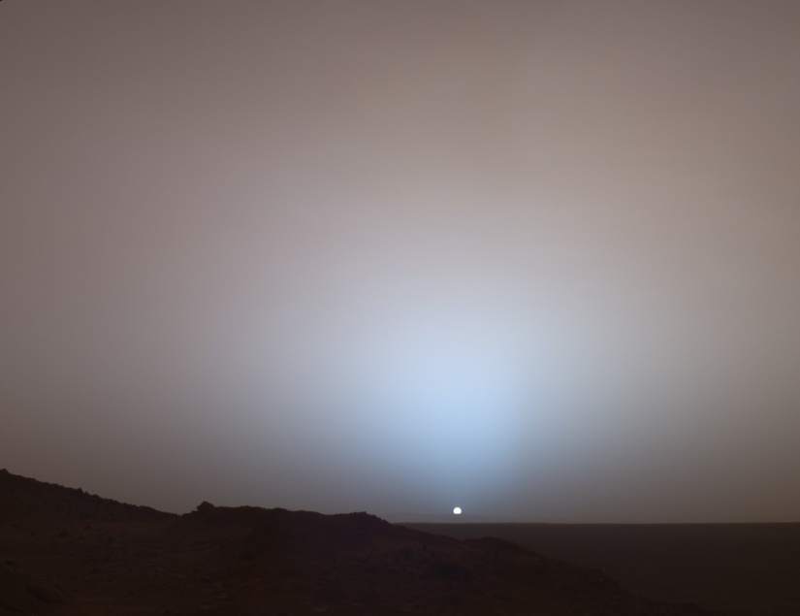
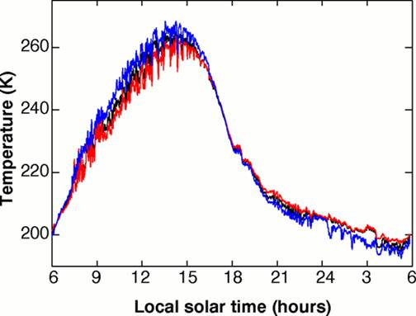
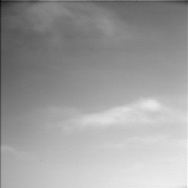
Martian atmosphere
Temperature at 25cm, 50 cm, 1m
-13°C
-33°C
-53°C
-73°C
Martian sunset as seen by Spirit
Diurnal cycle recorded by Pathfinder (1997) during Martian summer, 20°N
Clouds above Phoenix

Slide 13
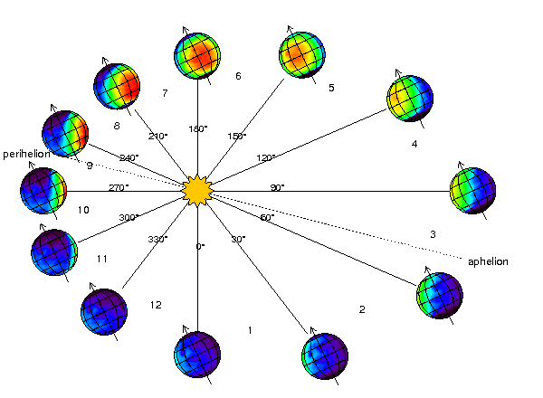
Mars seasonal cycle
Perihelion near Southern summer solstice
Use of Solar Longitude (L_{S}) as a « calendar »

Slide 14
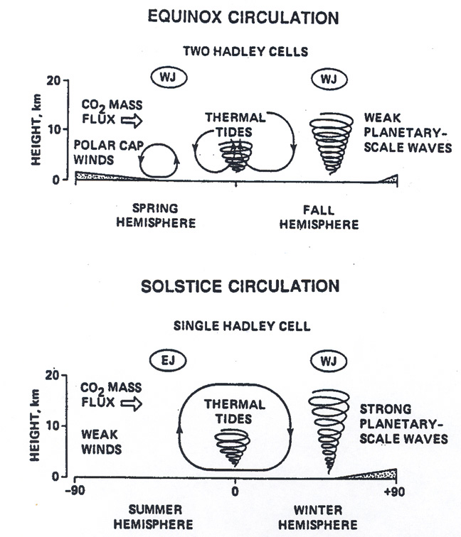
Mars’ atmospheric circulation
At solstices, poles are the warmest places
    Due to very low thermal inertia
  During solstices, single Hadley-cell redistributing heat from summer pole to winter pole
  More familiar picture at equinoxes
    two symmetrical Hadley cells, like on Earth

Slide 15
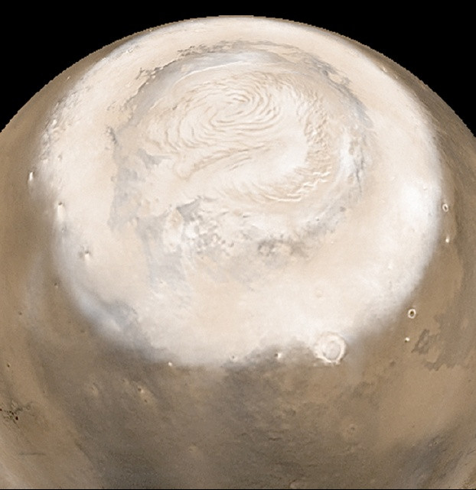
Mars’ polar caps
Northern : permanent H₂O + seasonal CO₂
  ~1000 km in diameter (summer)

Slide 16
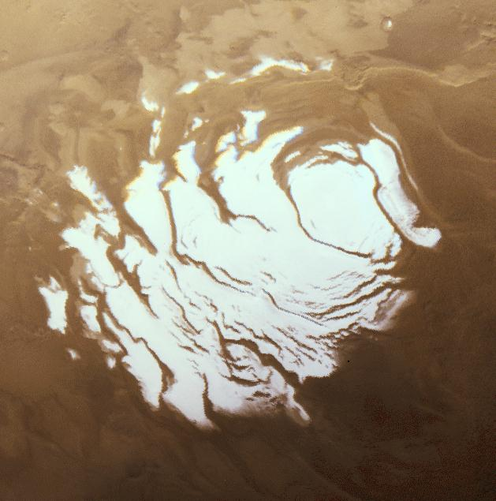
Mars’ polar caps
Southern : H₂O + CO₂ (both permanent)
  Diameter : ~350 km

Slide 17



Winter, polar night
-135°C

Slide 19
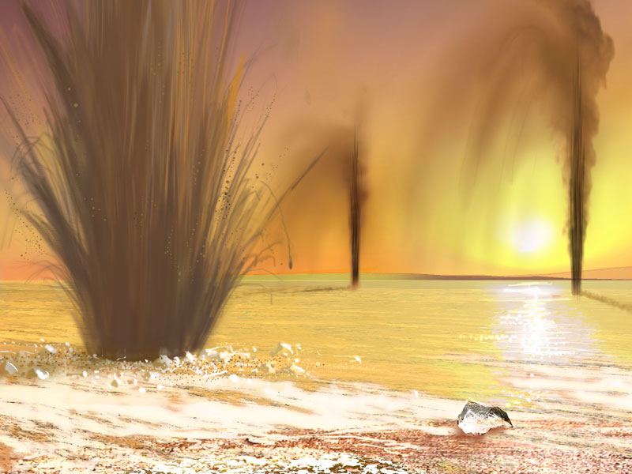

Slide 20
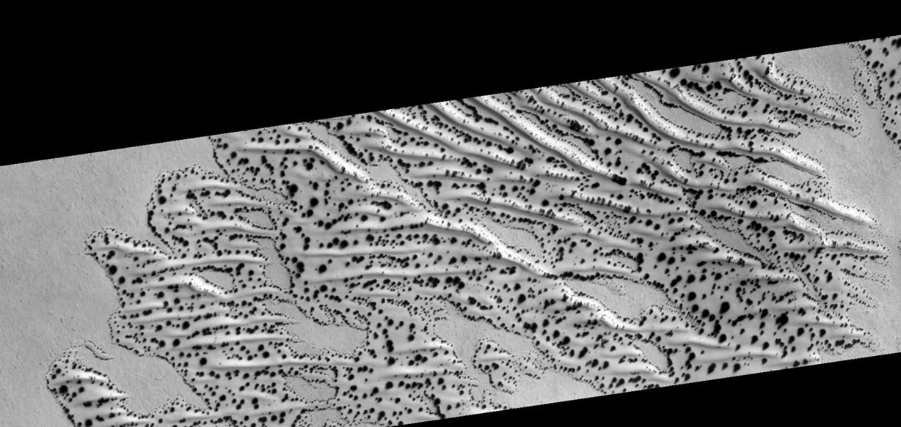
Dry (CO₂) ice sublimation
1 km

Slide 21
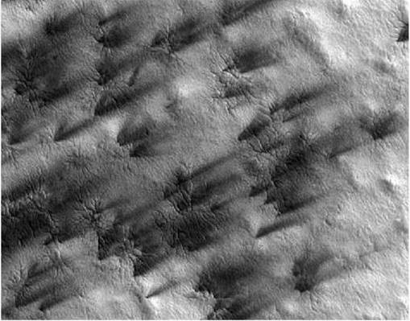
300 m

Slide 22
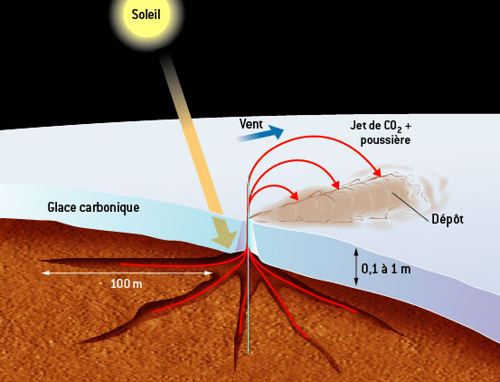

Slide 23
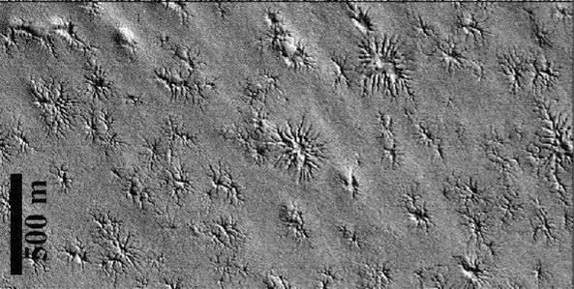
(Piqueux et al. 2003)

Slide 24
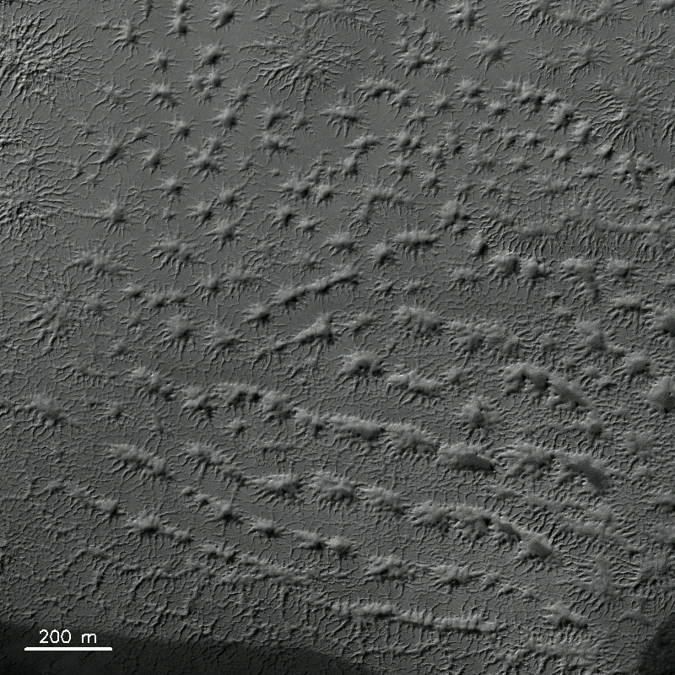

Slide 25
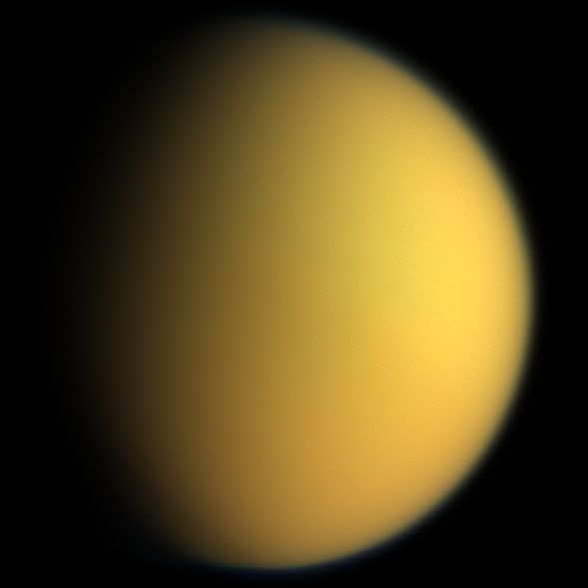
Titan
Icy body
    Silicate core
    Icy mantle and crust
    Larger than Mercury !
Dense atmosphere
    N₂ (95 %) & CH₄ (5 %)
      Clouds of ethane and methane
      Overlying thick yellowish photochemical haze (tholins)
    Surface pressure around 1.4 bar
Titan seen by Voyager

Slide 26
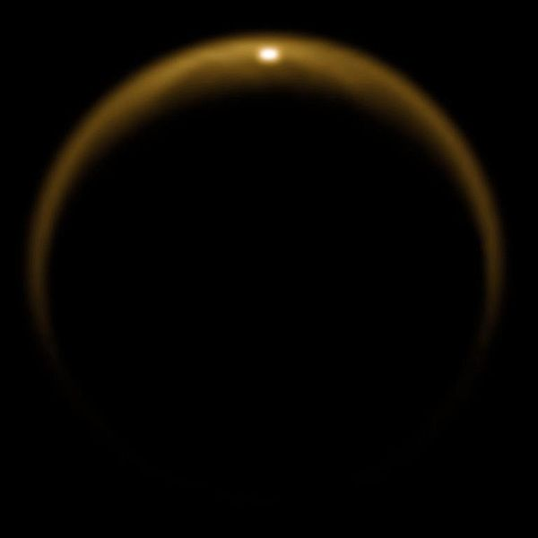
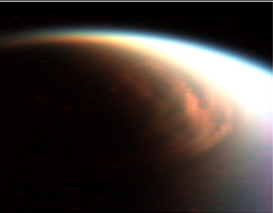
Titan’s atmospheric circulation
Single Hadley-cell
  From summer pole to winter pole
“Methanological” cycle
  Denser cloud cover in winter pole
  Precipitations (“Tropical climate”)
Specular reflection over a methane lake
Clouds (false colors) seen by Cassini over N. pole

Slide 27
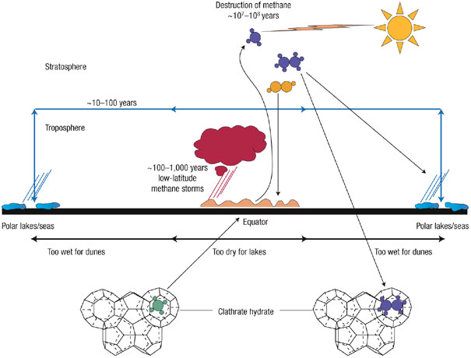
Titan’s methane cycle

Slide 28
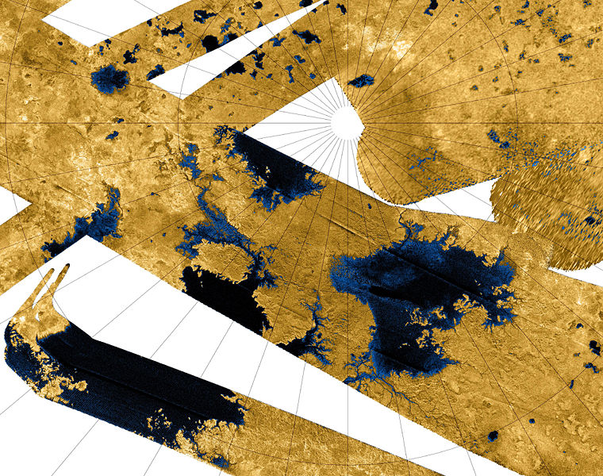
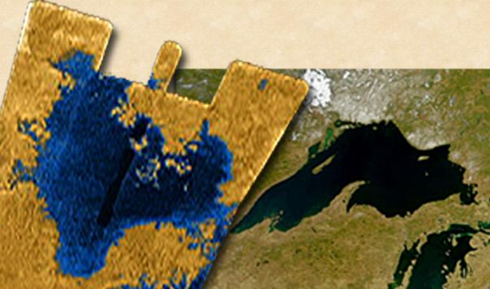
Titan’s lakes
Hydrocarbon lakes
  Only known liquid bodies in the whole Solar system except Earth’s water oceans and lakes.
Level variations
  More extended in the winter pole
Size comparison with Lake Superior
Radar composite image from Cassini (N . Pole)

Slide 29
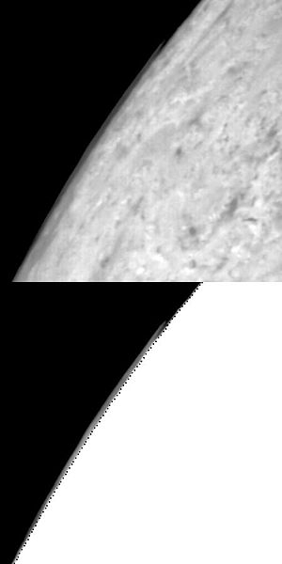
Triton
Largest satellite of Neptune
Thin atmosphere
    ~20 µbar (N₂)
Dynamics dominated by condensation fluxes
  N₂ sublimates in summer polar cap
  Condensates at winter polar cap
Cloud over the limb of Triton seen by Voyager 2

Slide 30
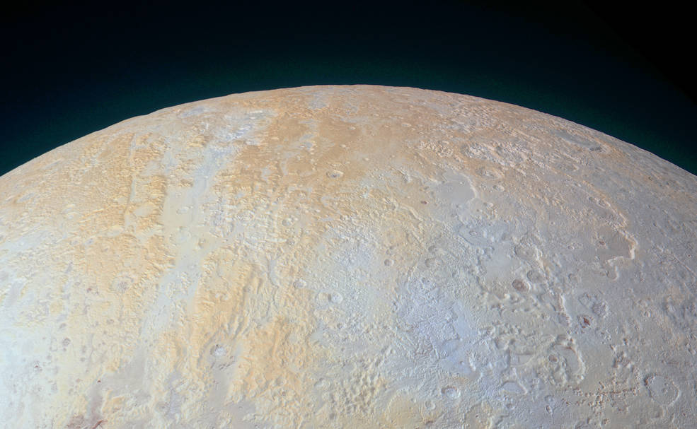
Pluto
Distinctive yellow-brown hue at N. pole
Relatively less nitrogen ice and more methane ice.
North pole of Pluto as seen by New Horizons
(enhanced color)

Slide 31
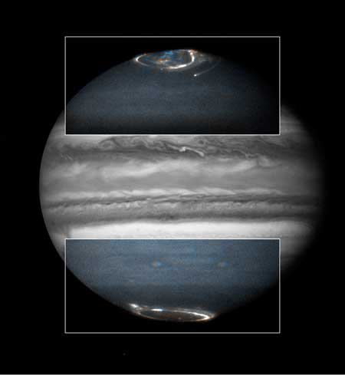
Jupiter
Strongest planetary magnetic field
  Strong auroral effects
Auroræ obersved on Jupiter in UV by HST

Slide 32
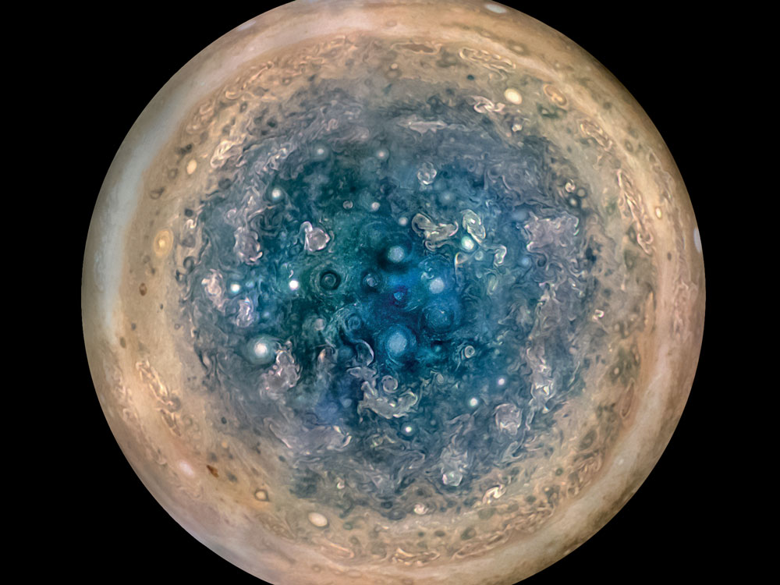
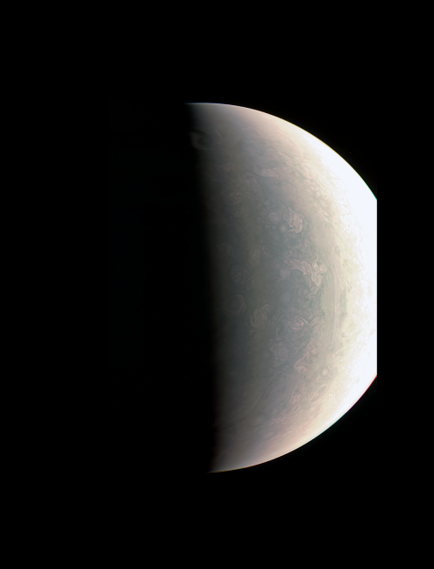
Jupiter
Dynamical effects
  Numerous transient cyclones at S. pole
  Less numerous at N. pole
Image centered on N. pole observed by Juno
Stacked images centered on S. pole observed by Juno

Slide 33
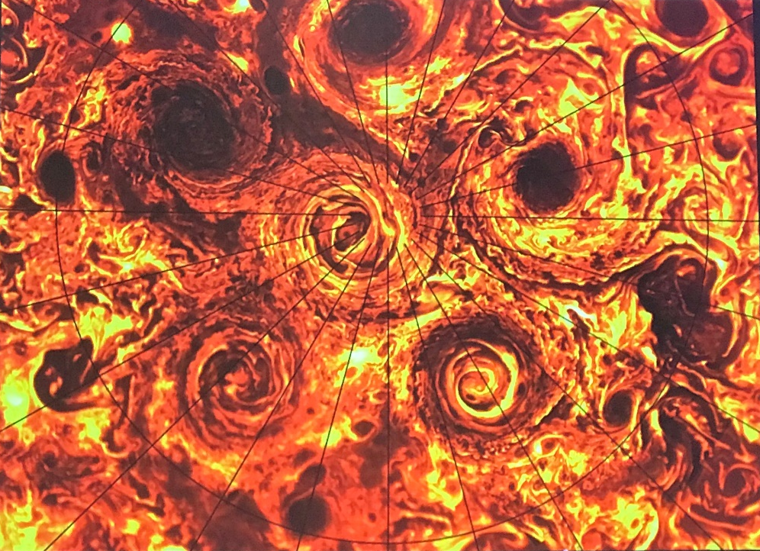
Jupiter
Dynamical effects
  Numerous transient cyclones at S. pole
  Less numerous at N. pole
Image centered on N. pole observed by Juno
Infrared view centered on S. pole observed by Juno

Slide 34
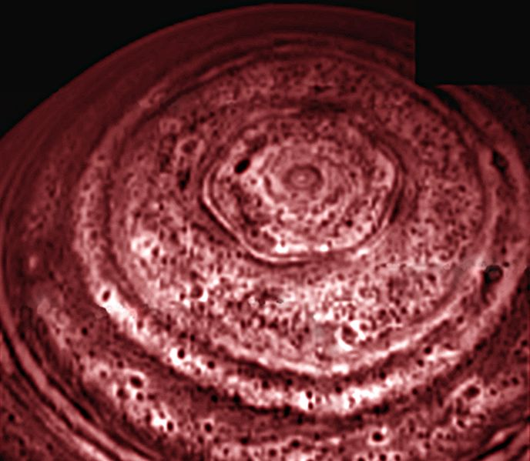
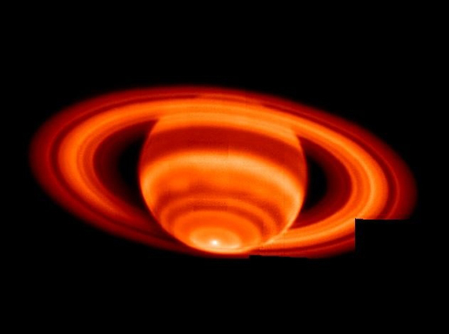
Saturn
Similar to Jupiter in most aspects
  Hexagonal northern vortex
Thermal emission from Saturn N. pole (Cassini)
Thermal emission from Saturn (Keck)

Slide 35
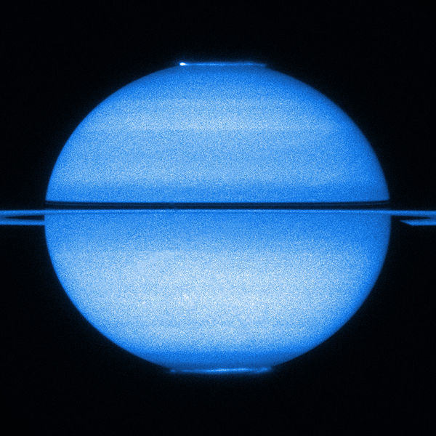
Saturn
Auroræ
Saturn observed by HST in the UV

Slide 36
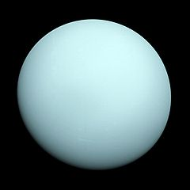
Uranus
Very strong axial tilt
  Polar regions most illuminated places
  Yet equator region appears warmer
    due to strong thermal inertia (seasonal lag)
Calm atmosphere
  Weak solar illumination
  Weak internal heat source
Uranus in 1986 observed by Voyager 2

Slide 37
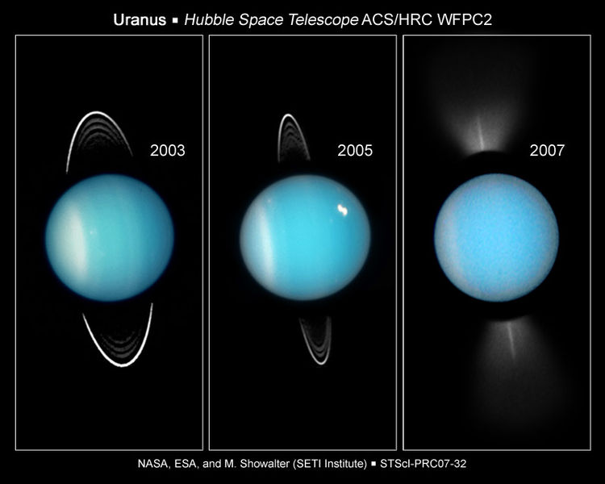
Uranus
Seasonal variability
  CH₄ ice cloud formation near summer pole?
Uranus observed by HST

Slide 38
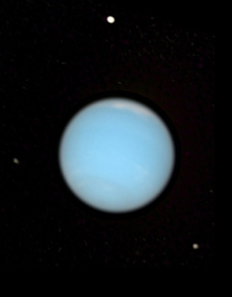
Neptune
Similar yet more active atmosphere than Uranus
    More powerful internal heat drive
Magnetic field
  Tilted to the rotational axis at 47°
  Offset at least 0.55 radius
Neptune seen by HST

Slide 39
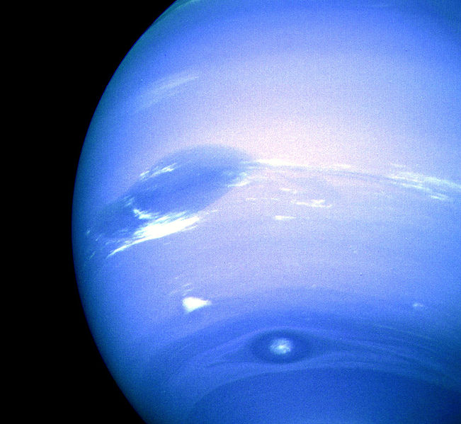
Neptune
Seasonal effects
  Currently southern summer
    ~40 Earth yr long
  10°C increase in temperature over Southern Pole near the tropopause measured in 2007.
    Sublimation of CH₄ possible
    Associated changes in cloud extent and albedo
Neptune seen by Voyager 2 in 1989 (contrast enhanced)

Slide 40
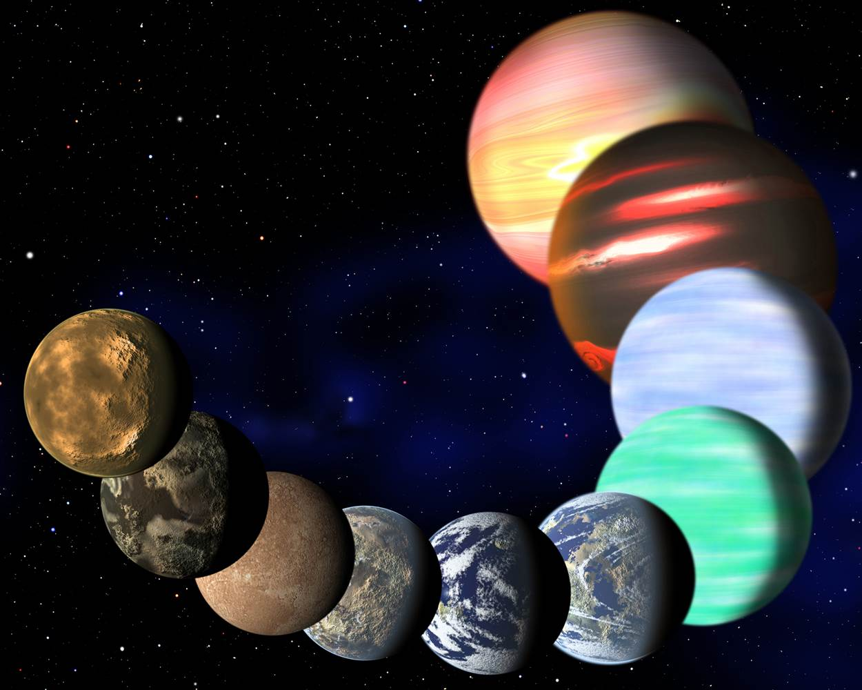
Extrasolar planets
Several thousands are known
  Most similar to Jupiter or Neptune, yet (much) hotter
  Some exhibit very eccentric orbits : strong eccentricity seasonal effects expected
  Axial tilts and rotation periods yet unknown
    Except for tidally locked planets
      Synchronous rotation
      No axial tilt

